Slide 1
Computer as Character
Kurtis Hassinger

Slide 2
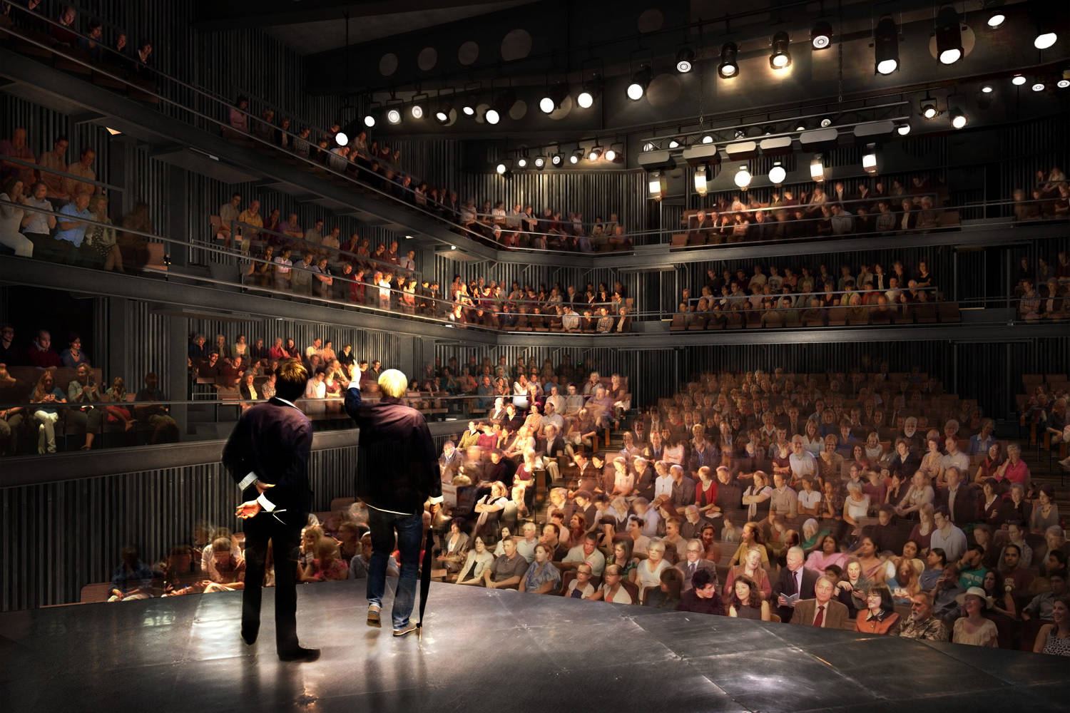
Tradition
Performance was mainly human agent to passive audience relationship pre 20th century

Slide 3
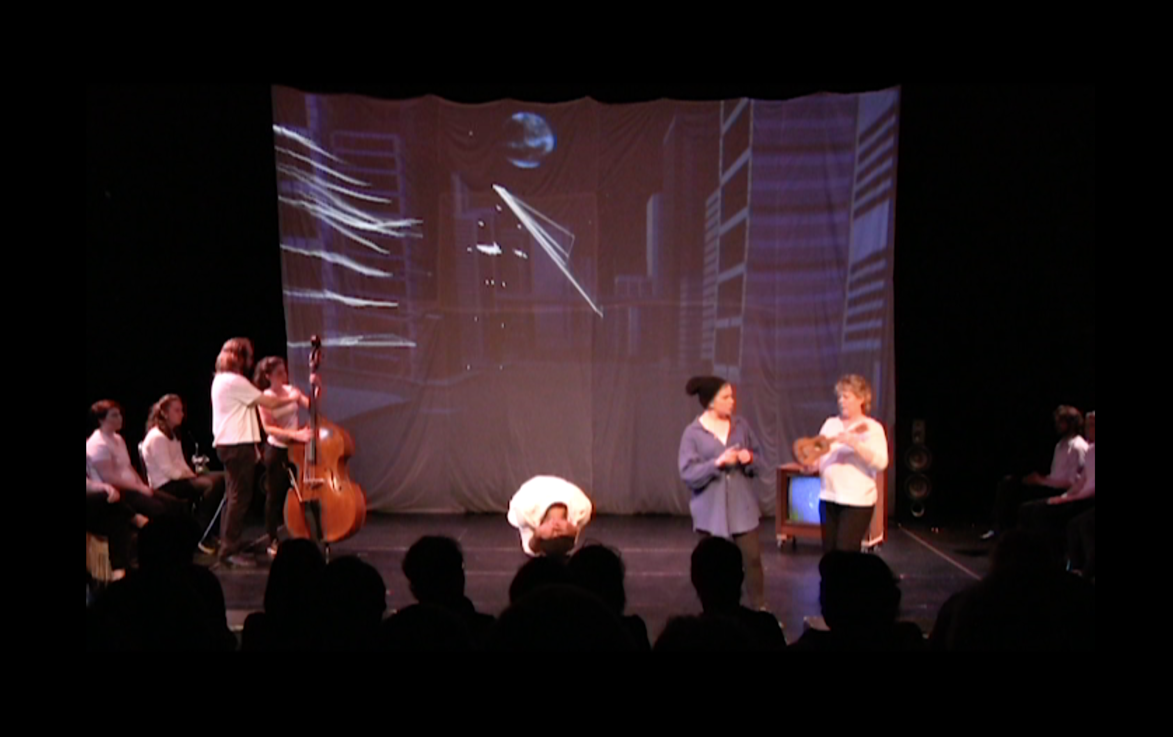
Mediatized UMT-Theatre and Dance production of Everyman
The Fluxus movement of the 60’s emphasized artistic process over final product

Slide 4
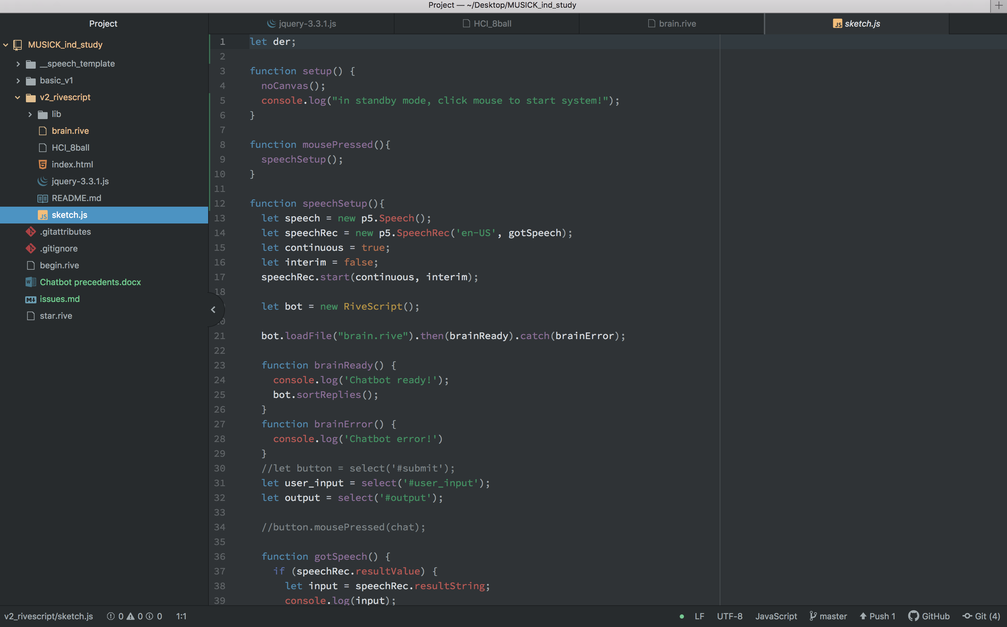
JavaScript
This performance utilizes Speech and Sound libraries in P5.js and the RiveScript coding language to create a chatbot interface

Slide 5
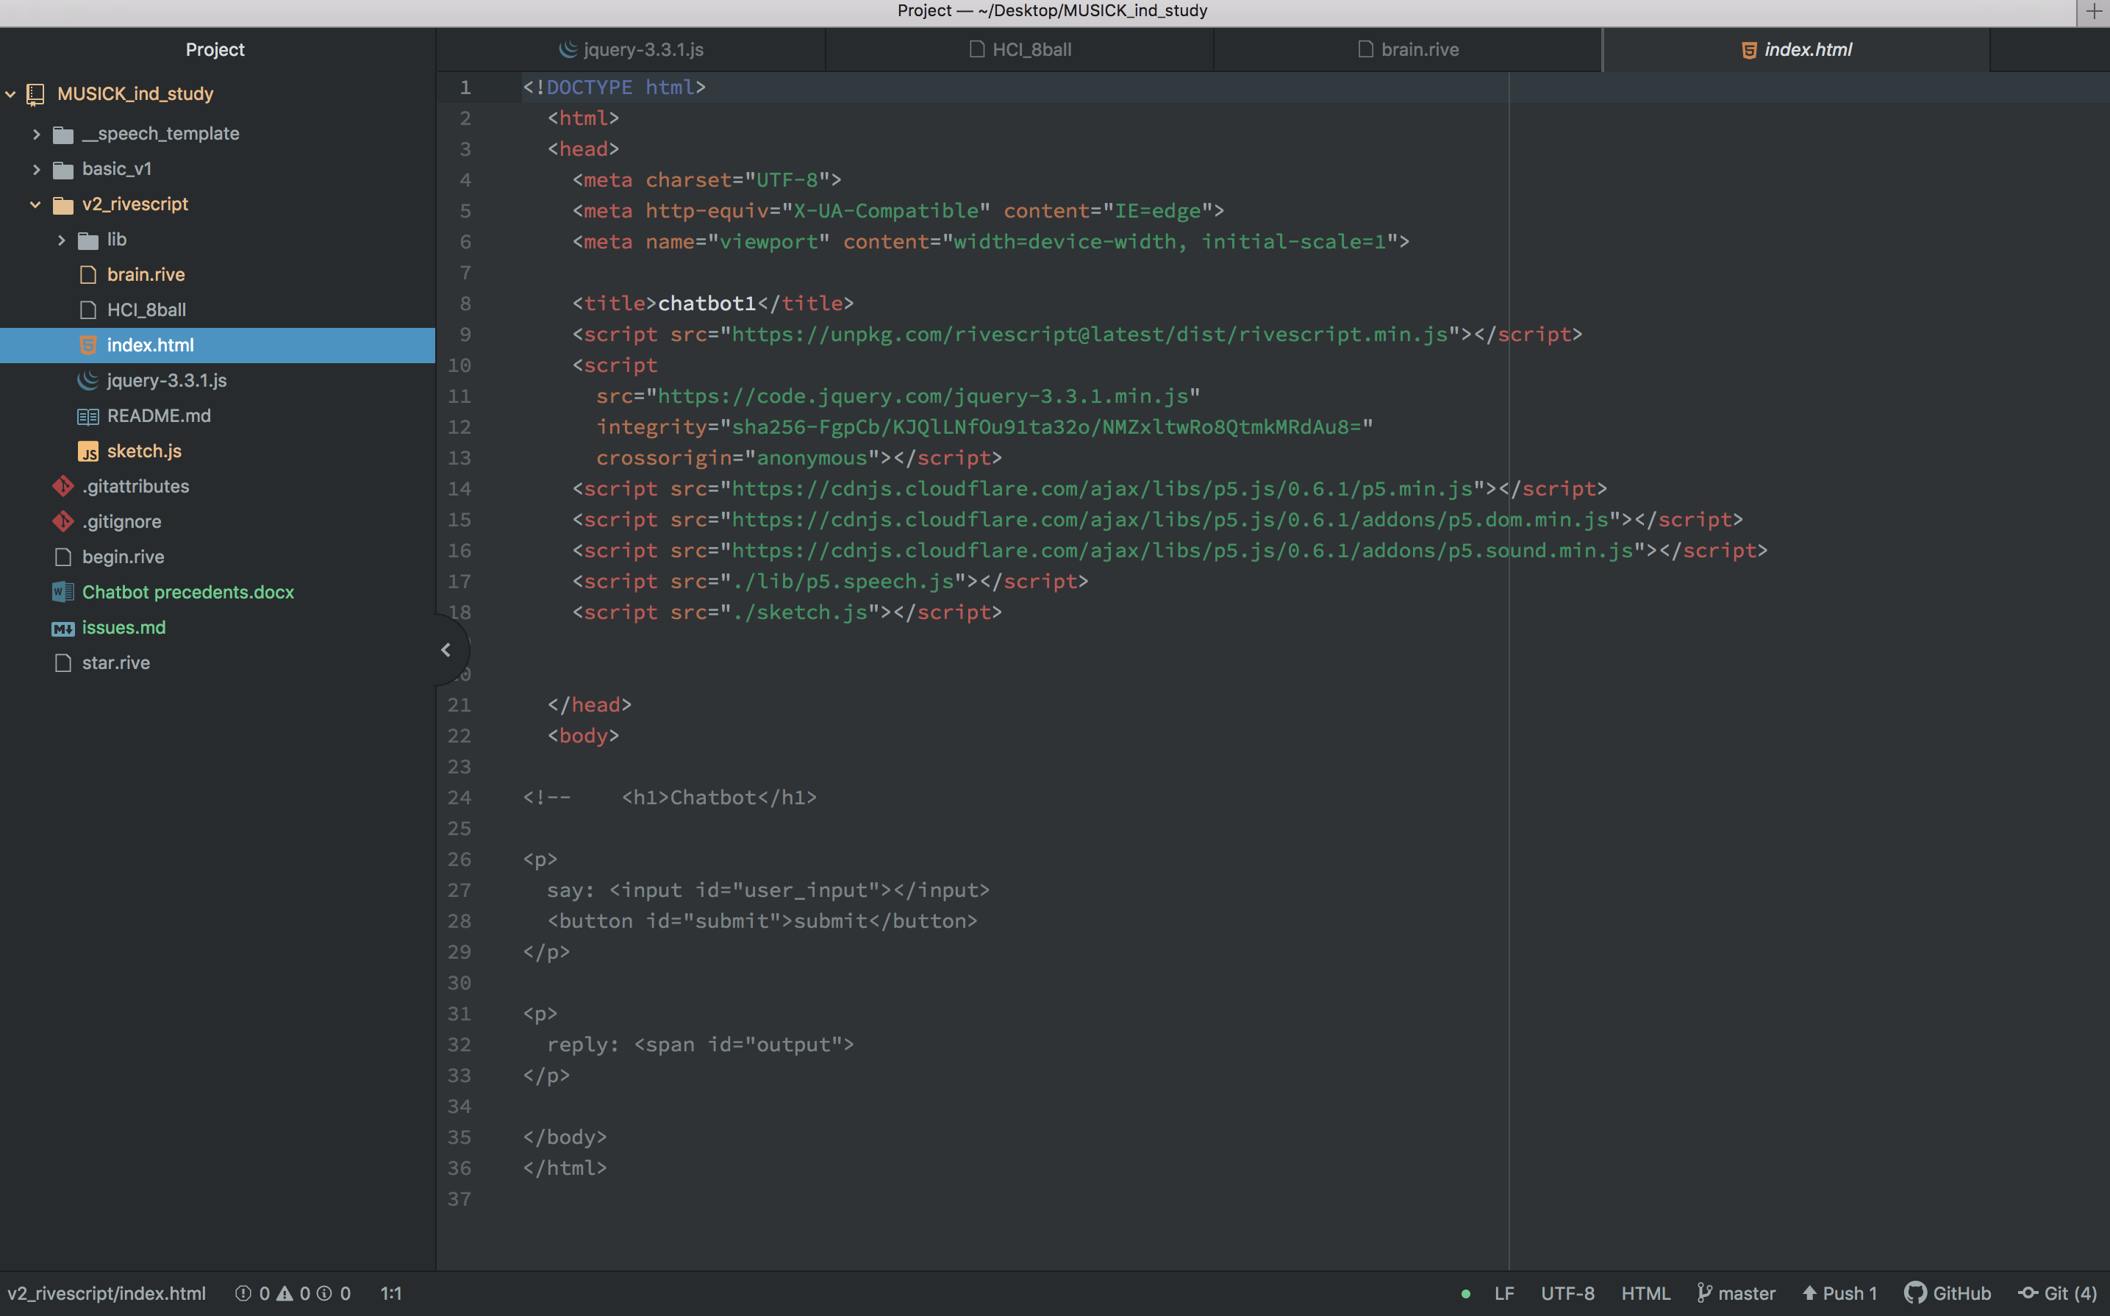
HTML
The performance is a two-agent system employing two separate computers engaged in conversation

Slide 6
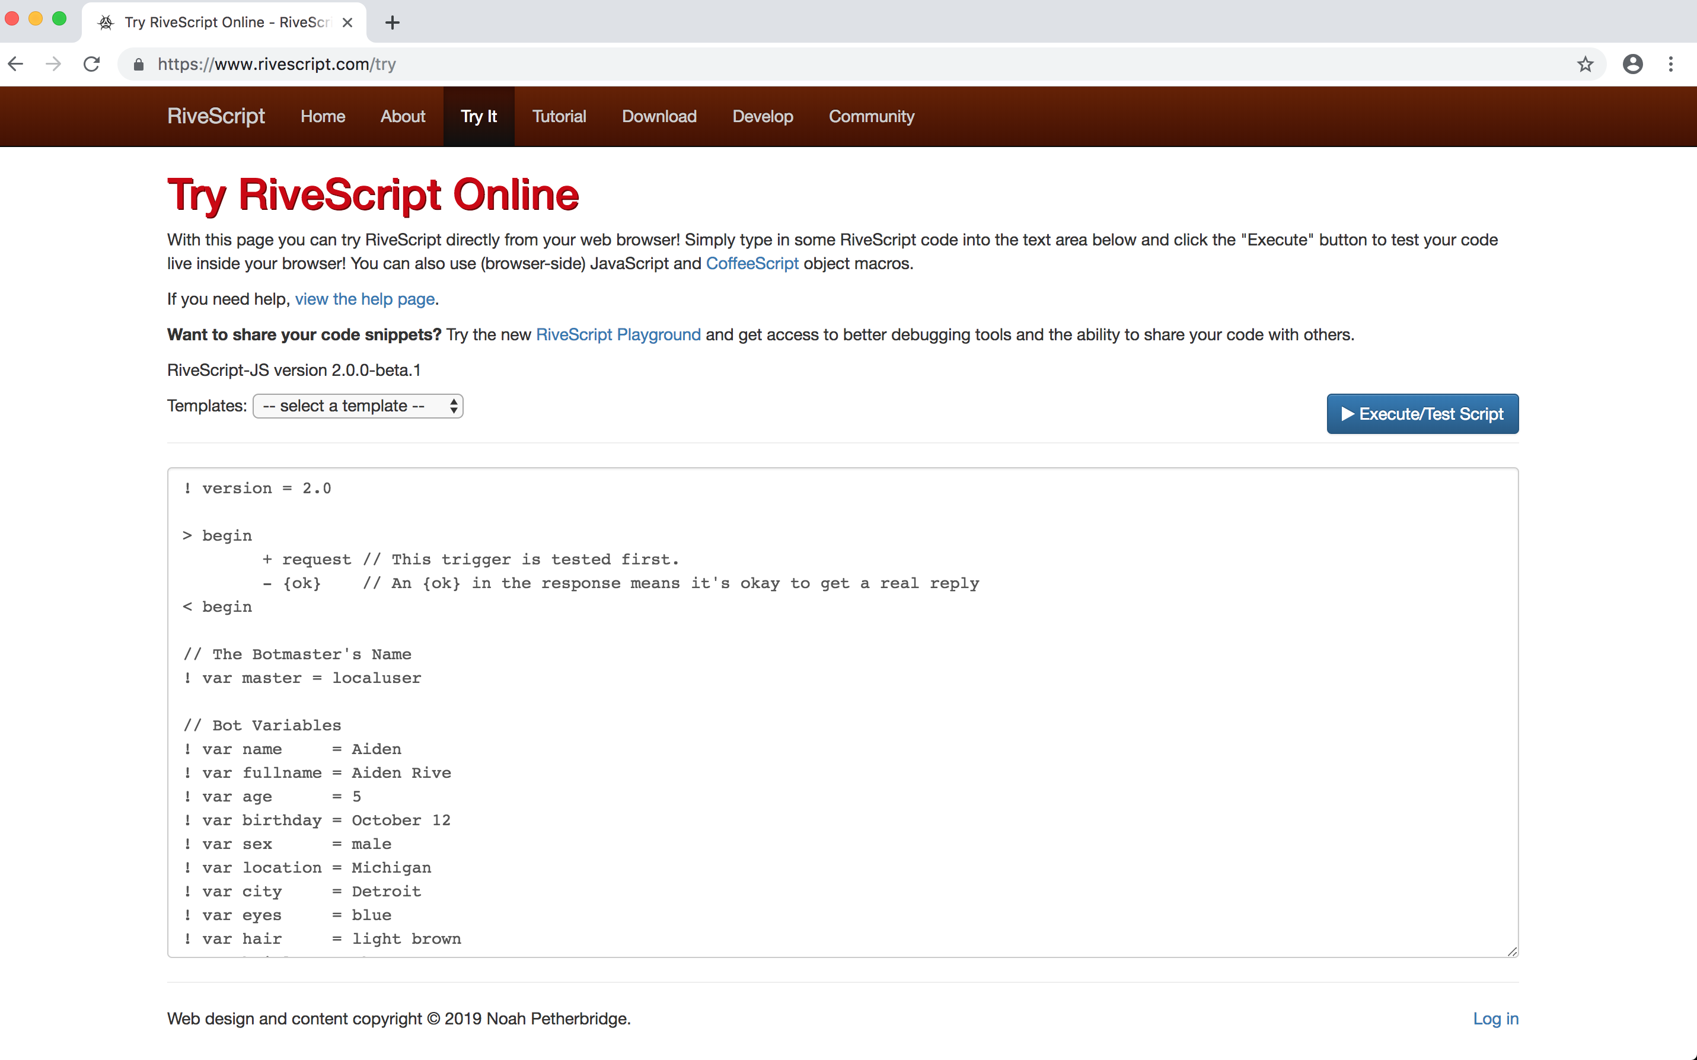
RiveScript
The computers discern sound from each other, match it to speech patterns,
and respond to questions and statements vocally, themselves.

Slide 7
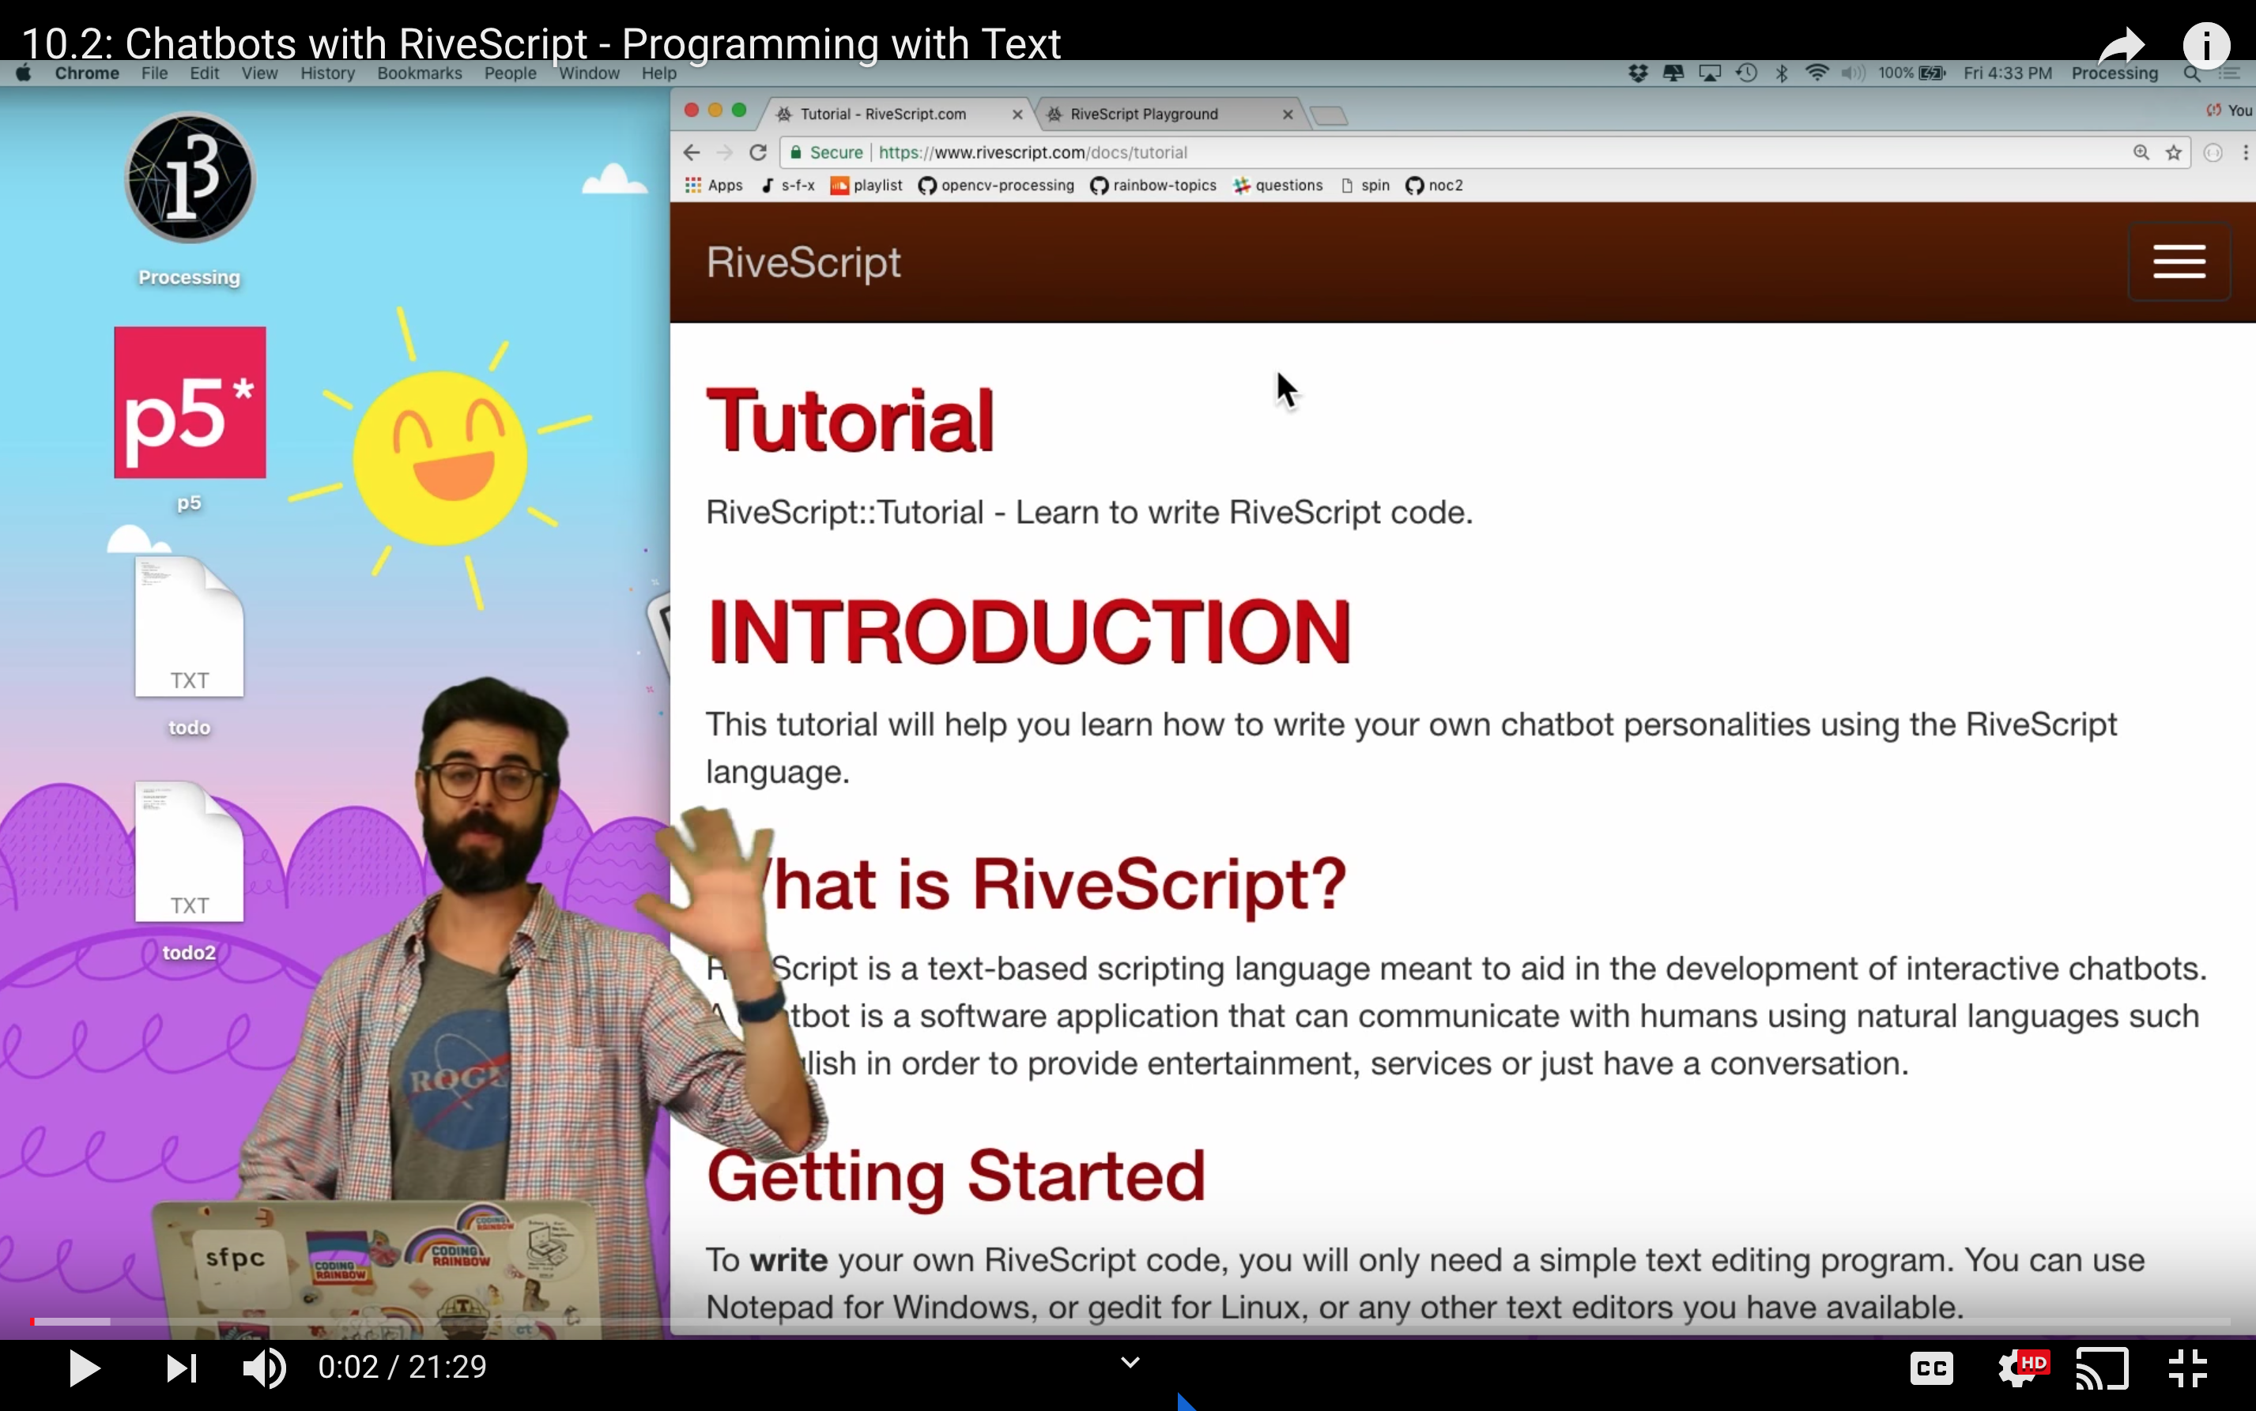
Daniel Shiffman and Coding Train
(in cooperation with NYU)
The system can be describe as a processor detecting audio input, analyzing it using pre-built libraries,
and producing sonic output that the processor finds to be the closest or most suitable responses to statements
or questions that the processor has analyzed

Slide 8
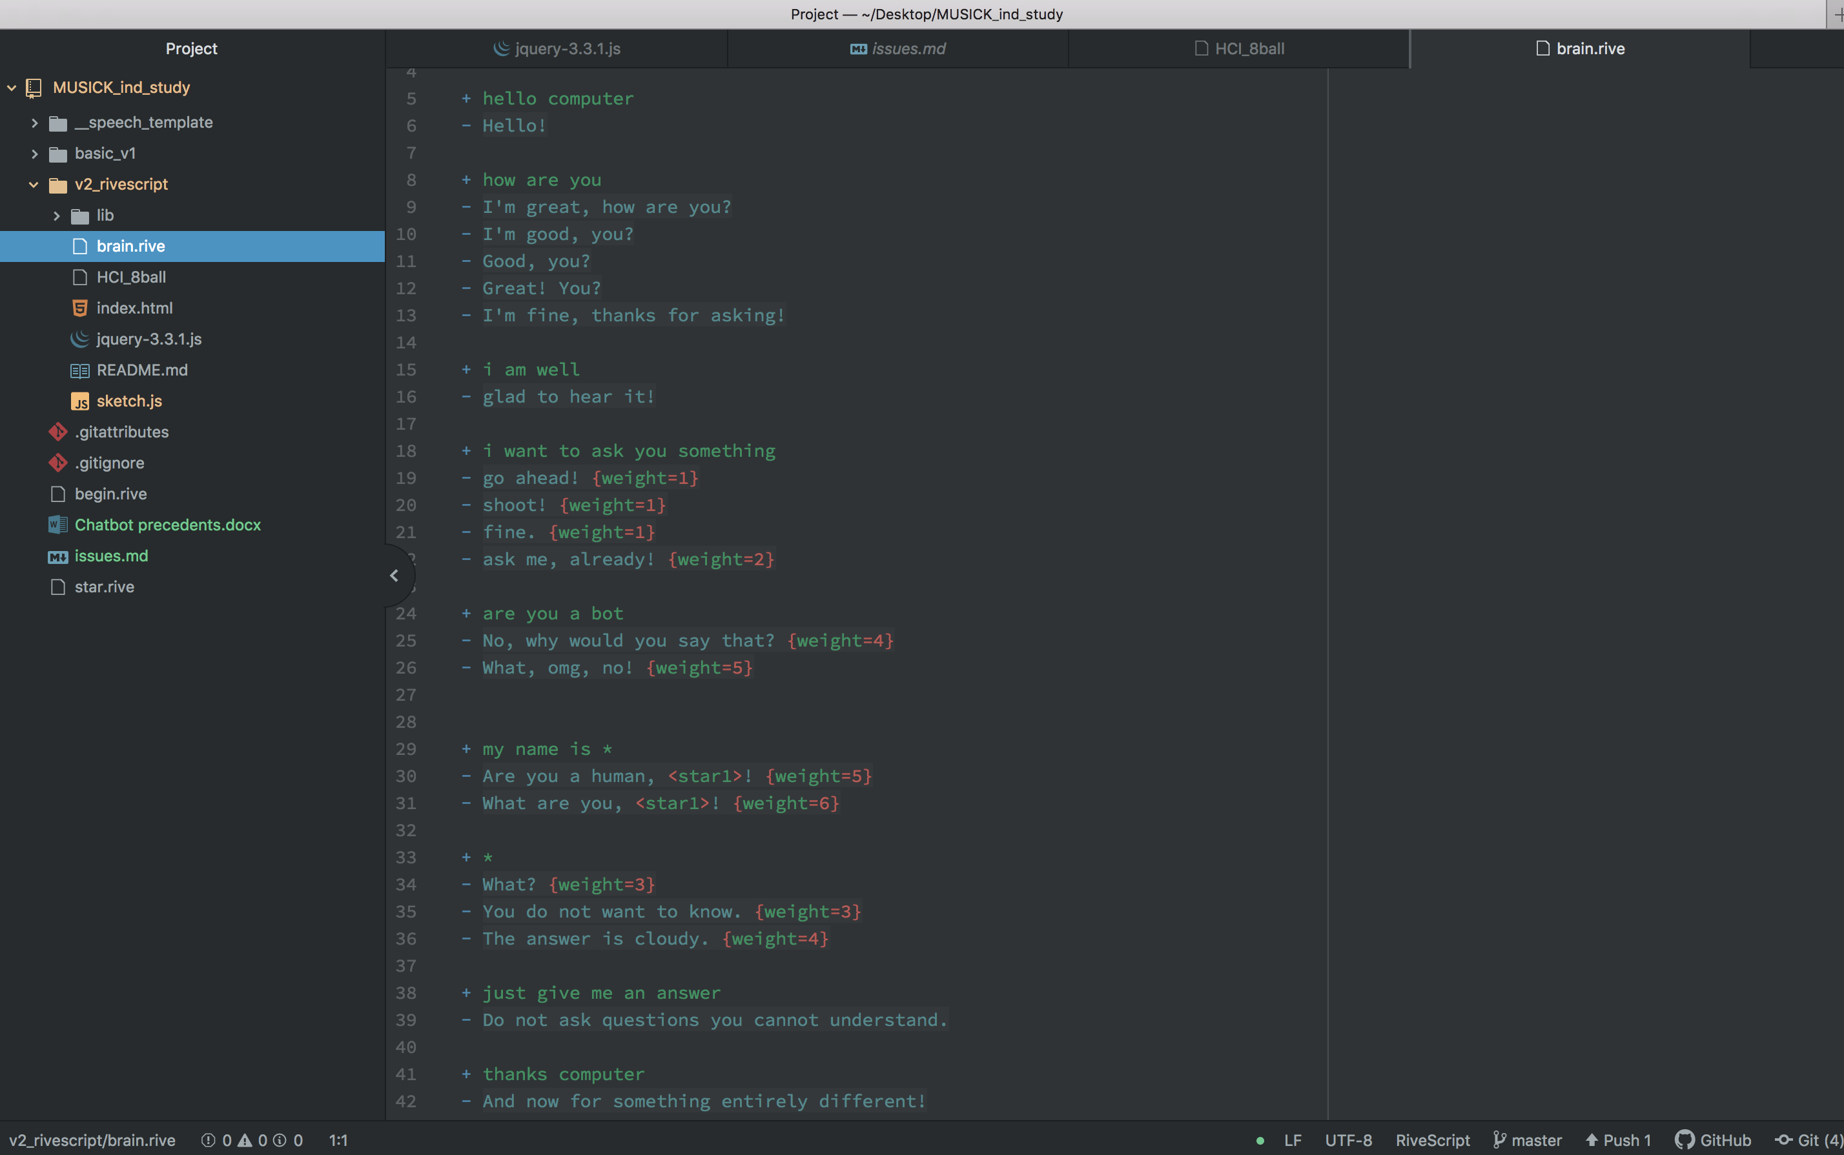
Chatbot
This ‘conversation’ is reactive but simulates an interactive performance in order to examine
greater questions of agency in liveness and the ‘performers’ involved

Slide 9
Future Performance
Output
Output
Input
Agent\Processor
Input
Agent\Processor
This will be the second iteration of a potential multiple-agent HCI
The workflow will begin with getting two computers to converse
And eventually culminate in a three agent system with human interaction

